Slide 1


HR Data Analysis
Shambhavi S
Data Analyst Intern

Slide 2


OBJECTIVES
The aim of this Project is to enhance PSYLIQ's hiring strategies using a data-driven approach. As a part of ETL (Extract, Transform, Load) Process, vital hiring data is extracted from PSYLIQ's records like EmployeeID, Job Roles, Education etc. Extracted data is then transformed using Power Query in Excel. Analyzed the data using PowerBI. Using DAX, created calculated tables. Used PowerBI Model to establish relationship between the datasets. Created Dashboard and Pivot tables to acquire deep insights of the data.

Slide 3
KEY INSIGHTS
Total Number of Employees = 4410 Average Age = 36.9 Attrition count = 711
Average years at the company = 7 Average Monthly Income = 65k
Employees with Technical background have 7.1 average years, whereas employees with Human Resource background have 4.8 average years at the company which is the lowest.
Highest monthly income is of the Sales Executive i.e. 63753k, Lowest is Human Resources i.e.9130k.
Work-life balance rating is highest in Research and development department, lowest in Human Resource.
From Job-satisfaction rating by Educational background, Life science have the highest and Human resources have the lowest rating.
Attrition count of Sales executives is at the top and Human resources is at the bottom .
Attrition count of Male is greater than female.

Slide 4
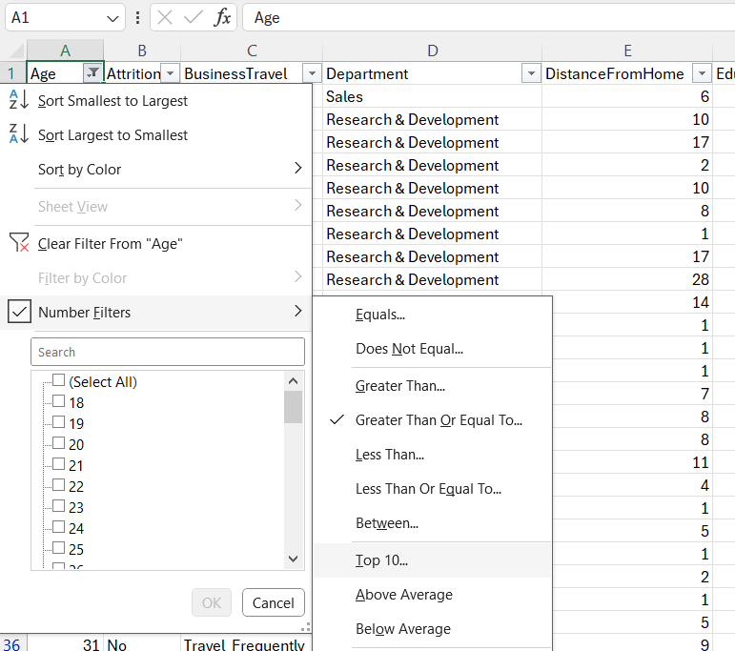
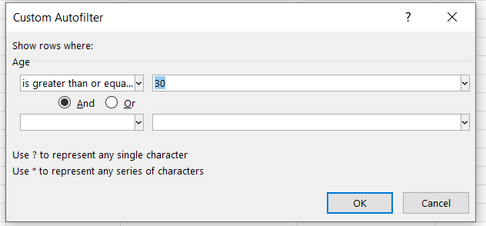
How would you filter the dataset to only show employees aged 30 and above?

Slide 5
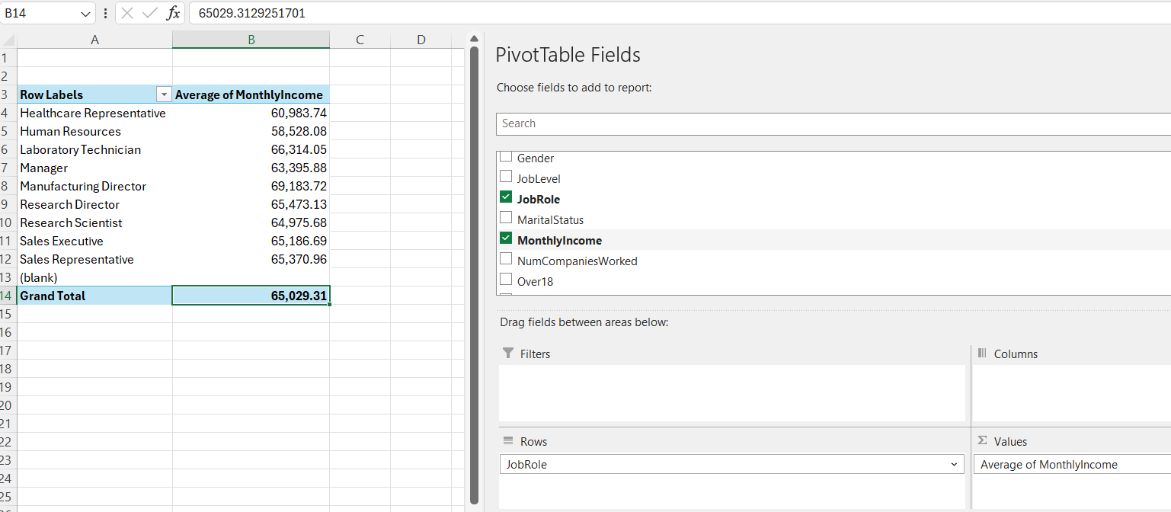
Create a pivot table to summarize the average Monthly Income by Job Role.

Slide 6
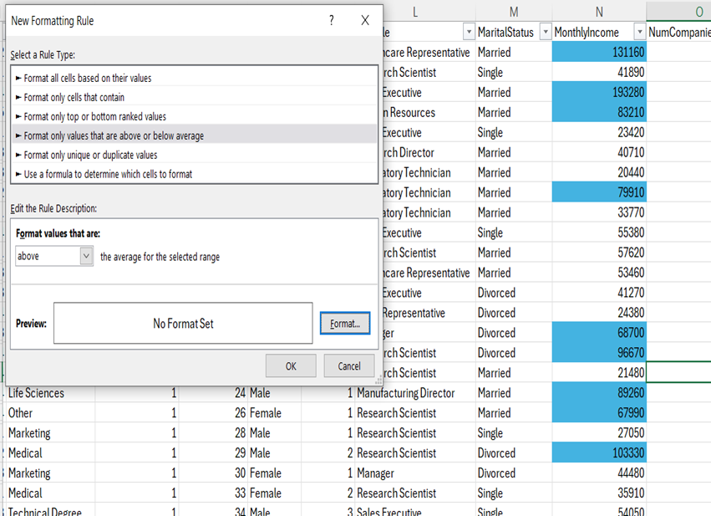
Apply conditional formatting to highlight employees with Monthly Income above the company's average income.

Slide 7
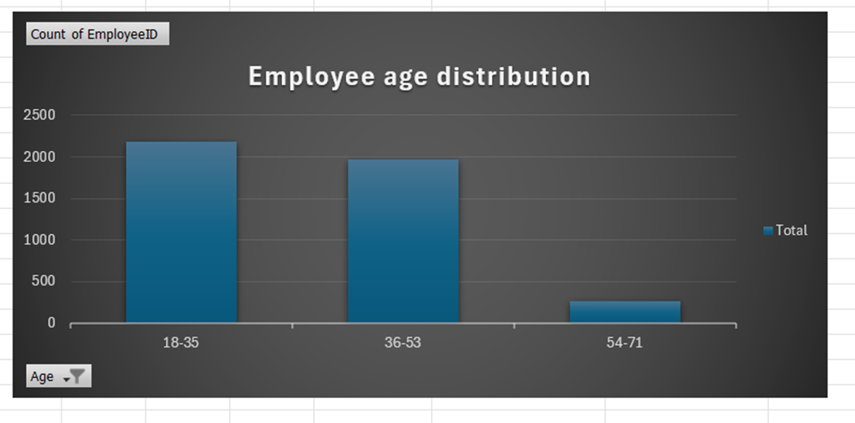
Create a bar chart in Excel to visualize the distribution of employee ages

Slide 8
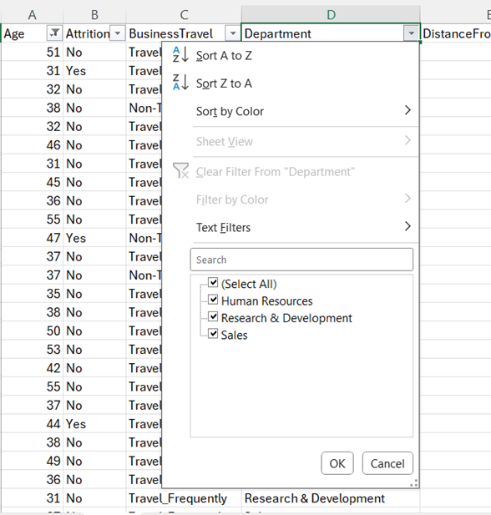
Identify and clean any missing or inconsistent data in the "Department" column
There is no missing data in the Department Column

Slide 9
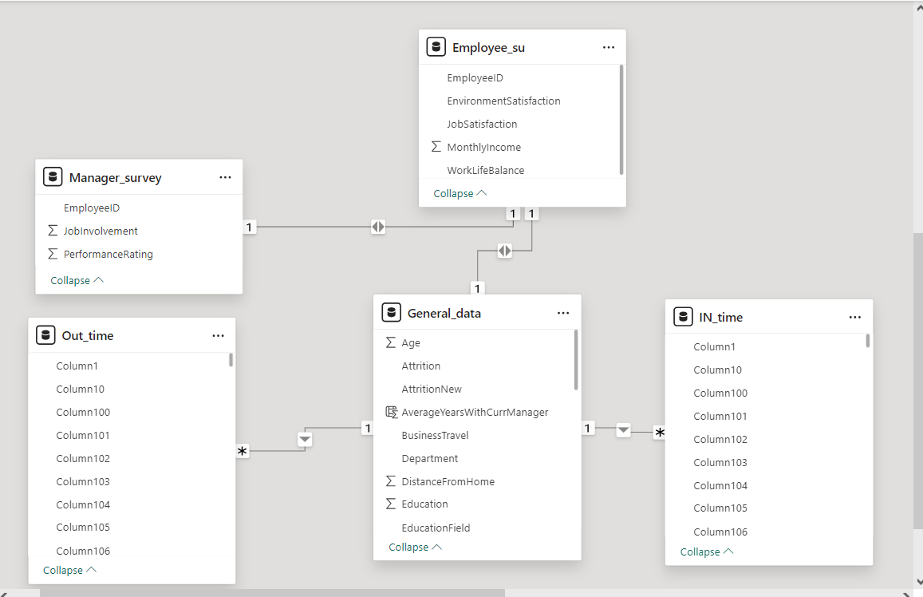
In Power BI, establish a relationship between the "EmployeeID" in the employee data and the "EmployeeID" in the time tracking data.

Slide 10
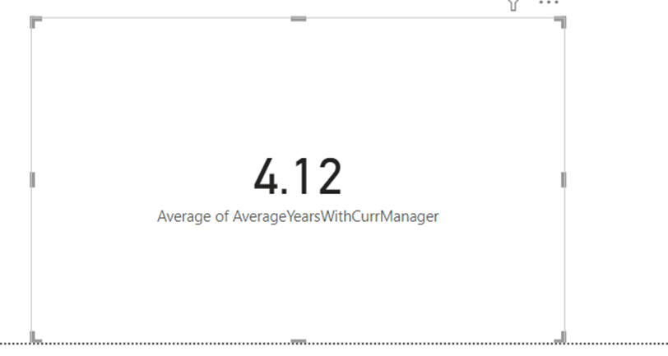
Using DAX, create a calculated column that calculates the average years an employee has spent with their current manager

Slide 11
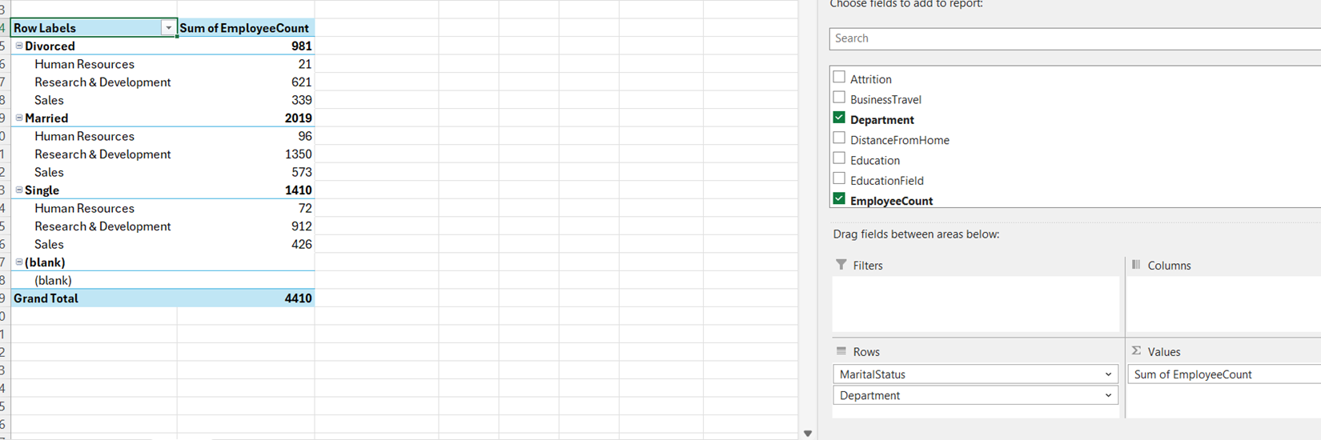
Using Excel, create a pivot table that displays the count of employees in each Marital Status category, segmented by Department

Slide 12
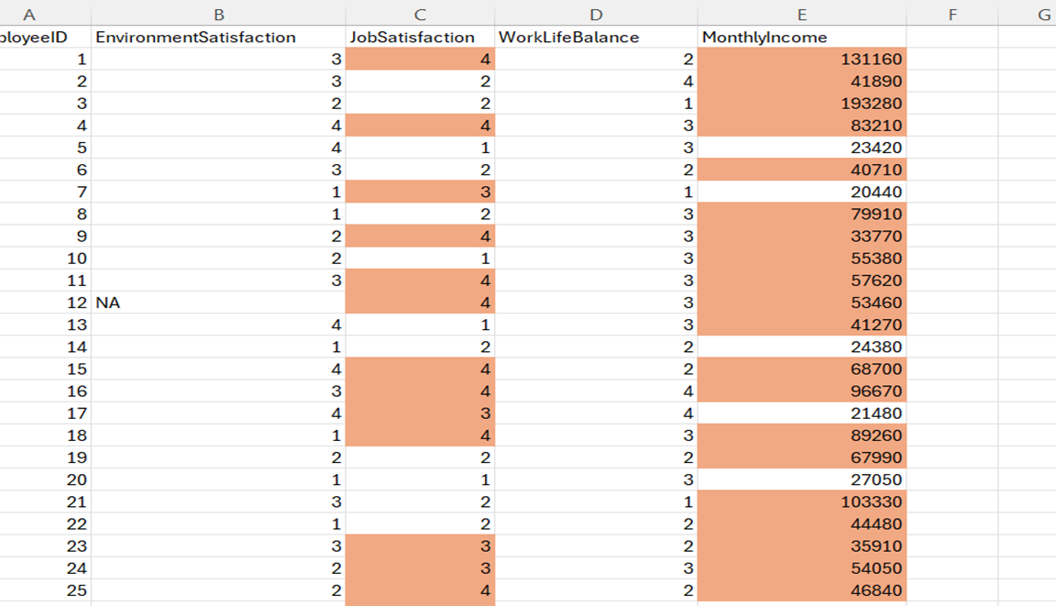
Apply conditional formatting to highlight employees with both above-average Monthly Income and above-average Job Satisfaction

Slide 13
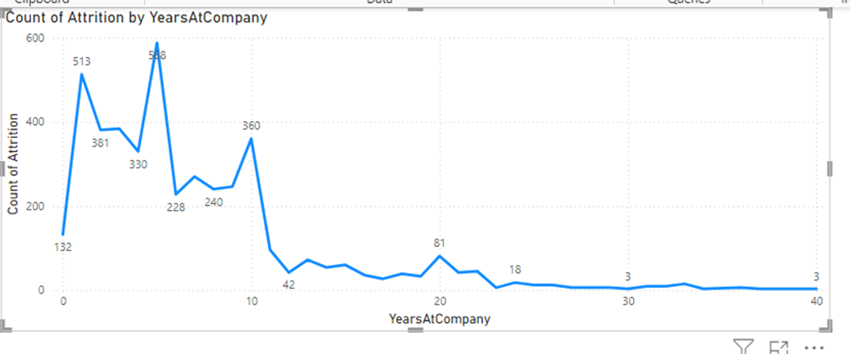
In Power BI, create a line chart that visualizes the trend of Employee Attrition over the years.

Slide 14
Describe how you would create a star schema for this dataset, explaining the benefits of doing so
Step 1: Import and load all datasets on Power BI
Step 2: Identify fact and dimension tables. Here General data is the fact table and manager survey, In-Out time, Employee data are dimension tables.
Step 3: Go to Model view, fact table is kept in the center and corresponding primary key i.e. EmployeeID in the dimension tables are connected.
Benefits of Star schema :
Simple to understand, implement and access the relevant information.
Can handle large volumes of data efficiently with faster query response.
Enables faster data refreshes, reducing the processing time significantly.

Slide 15
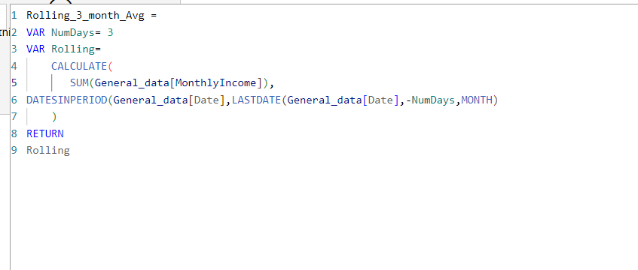
Using DAX, calculate the rolling 3-month average of Monthly Income for each employee

Slide 16
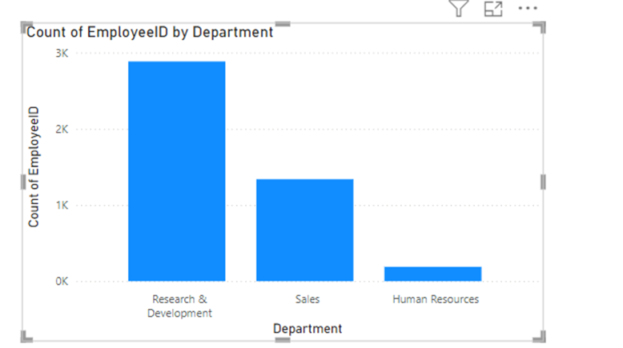
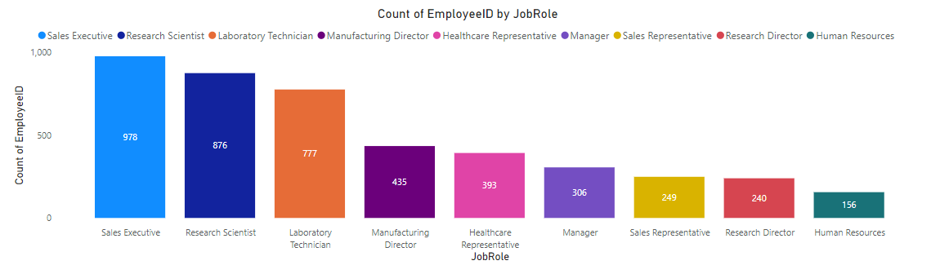
Create a hierarchy in Power BI that allows users to drill down from Department to Job Role to further narrow their analysis.

Slide 17
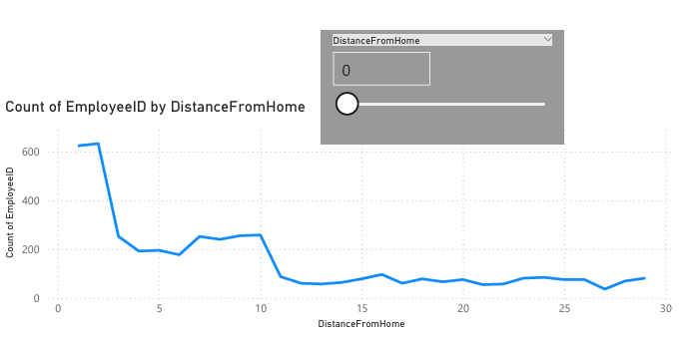
How can you set up parameterized queries in Power BI to allow users to filter data based on the Distance from Home column?

Slide 18
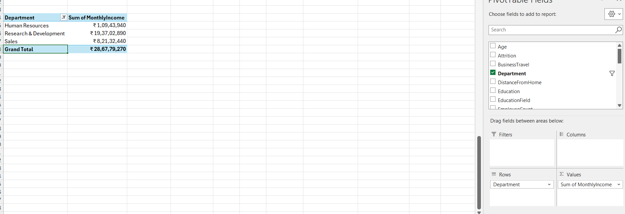
In Excel, calculate the total Monthly Income for each Department, considering only the employees with a Job Level greater than or equal to 3

Slide 19
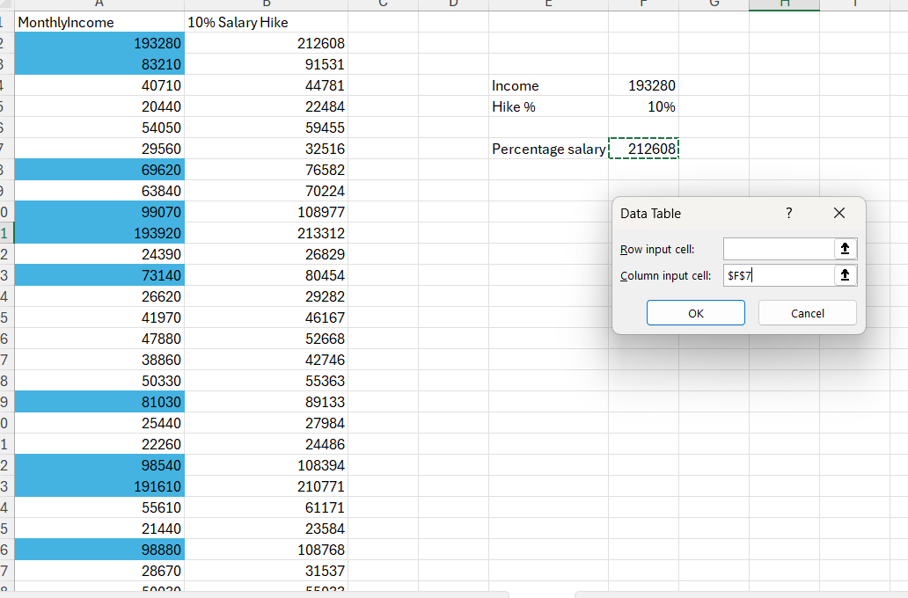
Explain how to perform a What-If analysis in Excel to understand the impact of a 10% increase in Percent Salary Hike on Monthly Income

Slide 20
Verify if the data adheres to a predefined schema. What actions would you take if you find inconsistencies?
First we need to make sure that the data model accurately represents the business domain and meet the business requirements.
Identify and correct errors, inconsistencies, or missing values in the data.
Use necessary data quality measures to resolve inconsistencies.

Slide 21
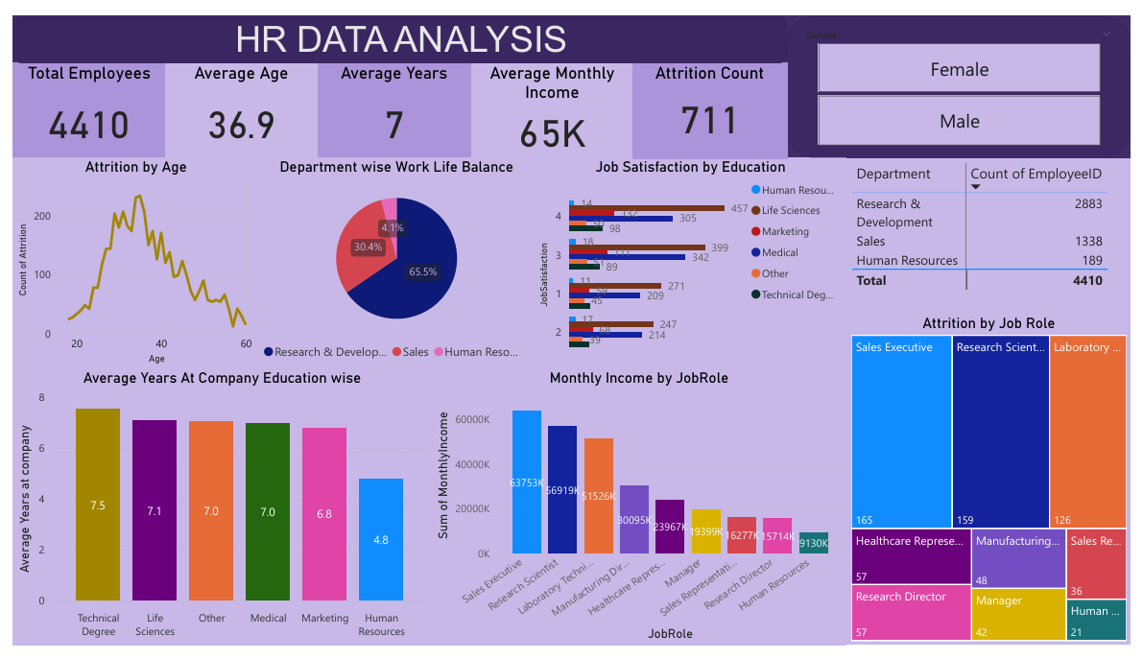

Slide 22

Thank You

